Slide 2
Summary and evaluation reports on the workshops
SZÁMALK-Salesian Post-Secondary Technical School

Slide 3
O3 Developing and testing workshops for schools
O3-A1: Create specific action plans for schools based on needs analysis and Digital Menu Card
O3-A2: Deliver workshops to teachers
O3-A3: Community learning content development

Slide 4
Indicators
Action plans are finalized by each partner school – timing and the responsible person is assigned - ready ☺
Workshop scripts and syllabi are prepared for each school in a standard template, min. 10 pages/ school - ready, uploaded ☺
Number of workshops delivered in partner VET schools - 15-20 sessions/school, each session lasting 120 minutes - ready, 15 sessions ☺
Number of VET teachers in workshops at schools – at least 10/school - ready, 10 teachers ☺
Number of newly developed digital learning content files added to repository (OER) per school – at least 30 (can be a video, or a questionnaire, a mind map, a timeline, an exercise or an online test) - ready, uploaded to the Moodle page ☺

Slide 5
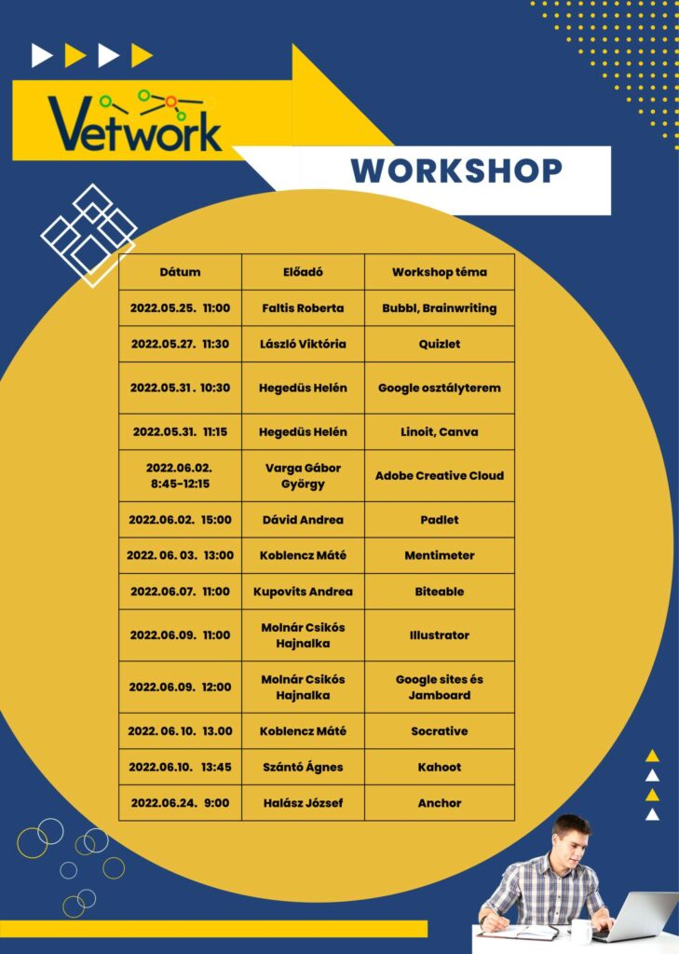
Workshops – 10 teachers
https://www.szamalk-szalezi.hu/online-workshop-orak-a-vetwork-projektben/

Slide 6
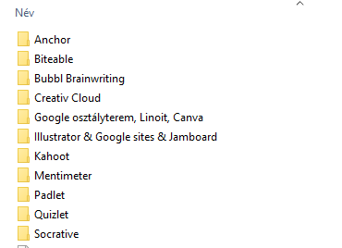
Community learning content development

Slide 7
Community learning content development

Slide 8
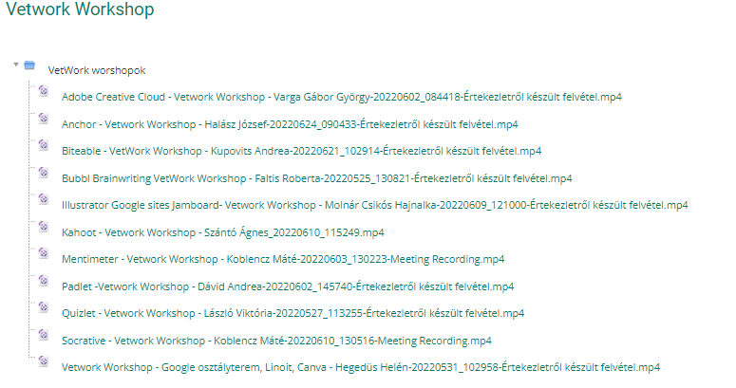
Workshops – Moodle page
https://etananyag.szamalk-szalezi.hu/course/view.php?id=1144
Password: VETWork_SZAMALK

Slide 9
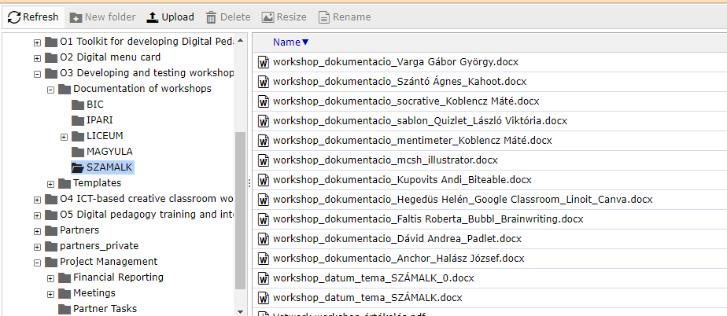
Documentation of workshops

Slide 10
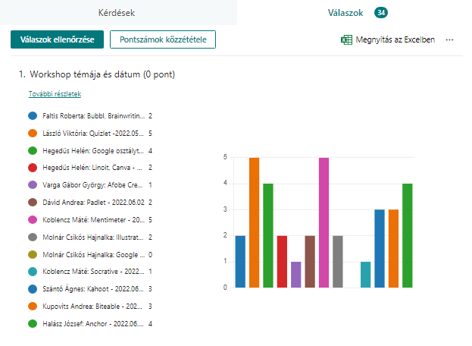
Evaluation of workshops

Slide 11
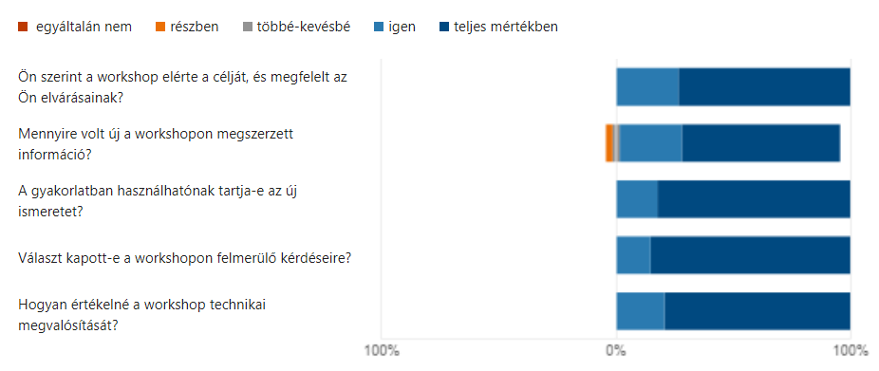
Evaluation of workshops

Slide 12
Evaluation of workshops - feedback
It was a professional presentation and participants have received a lot of practical advice. We could enrich our toolkit with many useful ideas during the workshop which had a pleasant, friendly atmosphere. Thank you!
Thank you for the informative, well-organized presentation and practical advice. It was really great, we could learn a lot.
The workshop was very practice-oriented, useful and superb. Thanks!
It was an excellent professional workshop. It was clear that the presenter really finds this digital tool efficient and uses it well in her own classes. Thank you for the opportunity that I could take part in this workshop!
It was a useful and interesting workshop. I am glad that I could learn something new.
The presentation was built up in a very logical way which really made me understand the whole system.

Slide 13
DMC tasks – looking back

Slide 14
DMC/Workshops/Digital lessons – Experiences/Conclusions
Tools and methods can all be found in one place, which is a very good opportunity.
Descriptions of tools and methods are very good.
Students highly appreciate the use of digital tools - teaching & learning become more efficient with the use of them.
Teachers can also experience being successful when using a new digital tool and/or method effectively.
Listening to and/or preparing for workshops proved to be highly useful.
DMC suggestions/recommendations:
Constant expansion and development is necessary to successfully maintain such a page, which, of course, is labour-intensive, but this is the only way to make users continuously revisit such a repository.
If there is a change on the interface, it would be great if we could get notifications to see how the applications we use have been altered.

